Slide 1
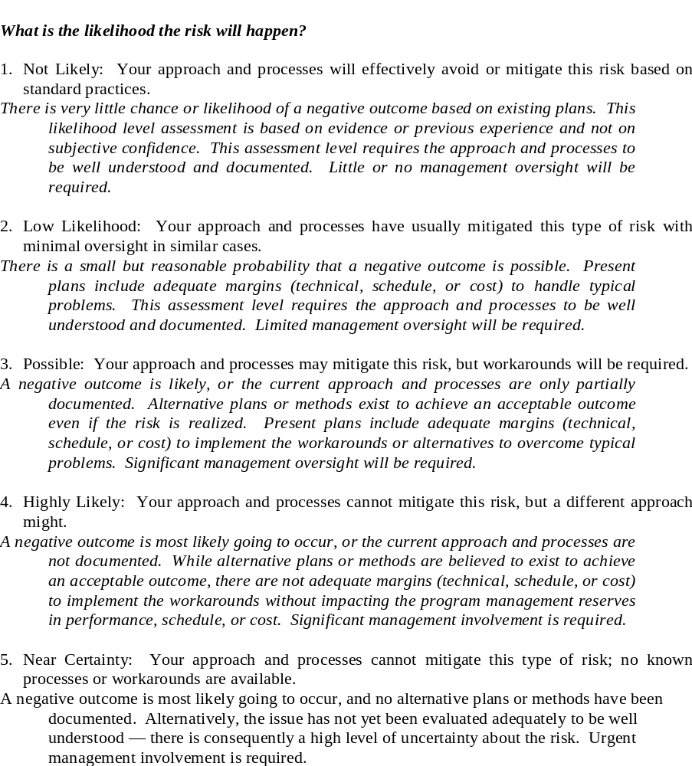
Example Definitions
Probability/Likelihood Definitions

Slide 2
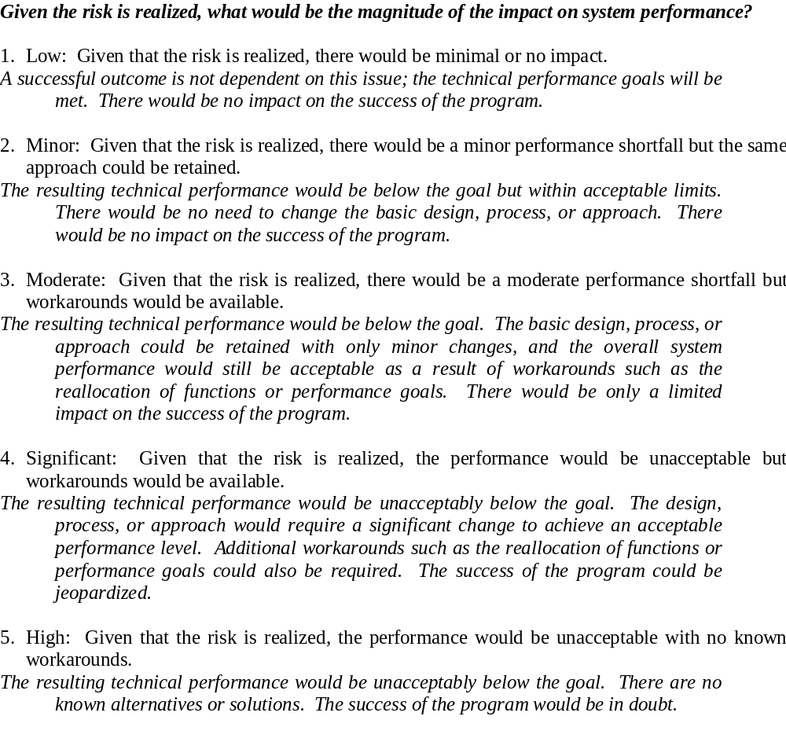
Example Definitions
Technical Impact/Consequence Definitions

Slide 3
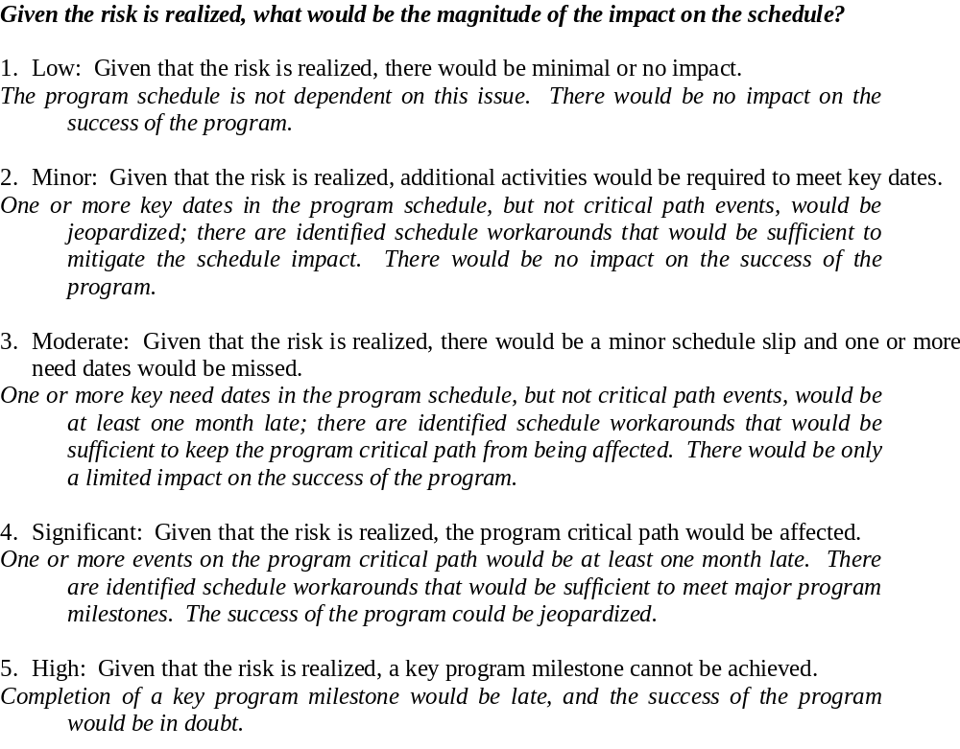
Example Definitions
Schedule Impact/Consequence Definitions

Slide 4
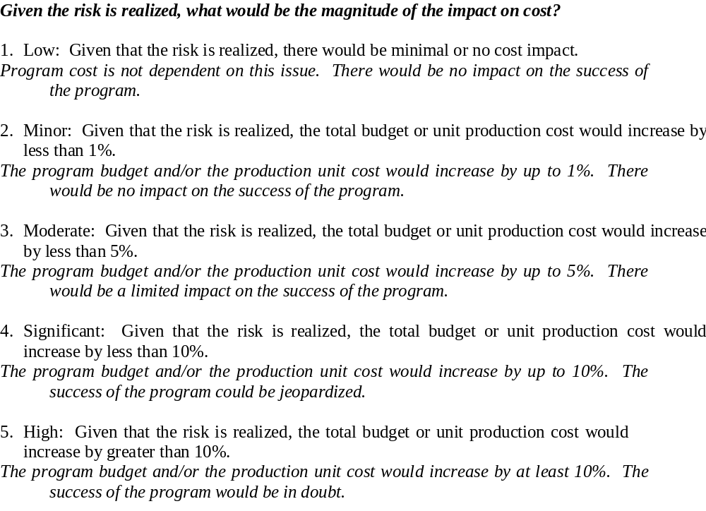
Example Definitions
Cost Impact/Consequence Definitions

